Slide 1
NetHope CIO Challenge –
Overcoming Obstacles
22 October 2015
Edward Happ
Global CIO, IFRC

Slide 2
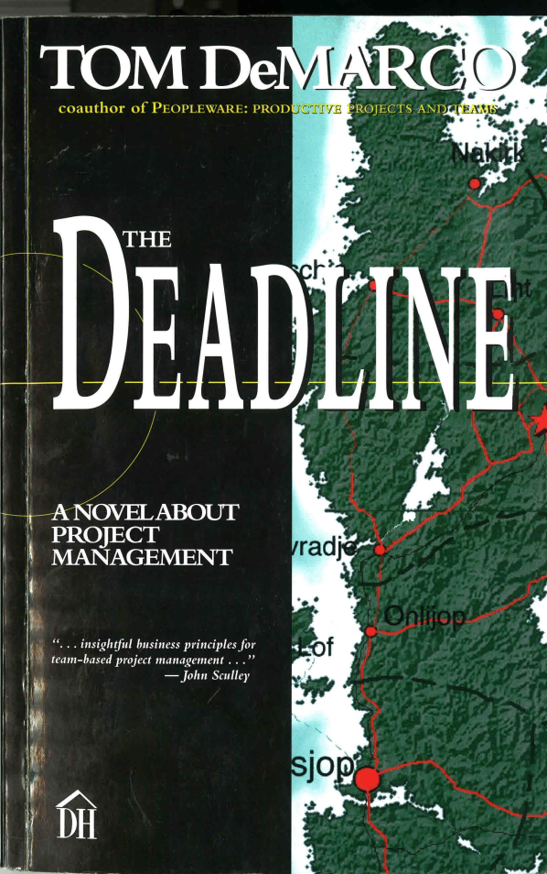
A Project Management Novel?
The case of the sinister Minister Belok…

Slide 3
Story Recap
Thompson in charge of six large projects in Morovia
Ultimate senior management supporter, Nation’s Noble Leader (NNL)
Dream team: Belinda, Gabriel
“…first time in his professional life that he had been turned loose to do the best work he could…”
Then NNL leaves, the tyrant Belok left in charge
He takes 186 days out of the schedule and combines teams because “lateness costs money”, qtr of million per day in profit

Slide 4
What did you learn from this story?
What would you do?
What “pathological political” situations have you seen in your work?
How did the team solve the problem?
What was Thompson’s leadership style?

Slide 5
My Take-aways
#1: the power of the AND is greater than the power of the OR
Remember: We are here “to do good work and to learn”
A key indicator of power politics is the refusal to listen…”I will not hear talk of delivering any later than that”…”Do as you're told”
“There is no such thing as a job with no politics”
The answer came from the team not the leader
A gelled team is your most valuable project asset
Breaking the iron triangle of projects: senior management can control only 2 but must give the 3rd to the project team

Slide 6
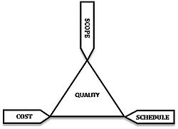
The Iron Triangle – Seek to Optimize Three Factors
The client can only demand two
See http://en.wikipedia.org/wiki/Project_management_triangle

Slide 7
Thompson's Journal
Pathological Politics
You have to be willing to put your job on the line any day…
…but that doesn’t guarantee that pathological politics won’t affect you
PP can crop up anywhere, even in the healthiest organization
The defining characteristic of PP is that goals of personal power and influence come to override natural goals of an organization
This can happen even when the pathological goal is directly opposed to the organizational goal
Among the bad side effects of pathology: it becomes unsafe to have a leanly staffed project

Slide 9
Appendix

Slide 10
A PM Decision Framework
QH = Quick-hit, bare-bones PM;
PMI = Project Management Institute (waterfall PM)

Slide 11
Project Management Methodologies
Participative
Iterative,
High Collaboration
XP
Agile
Heavy
Weight,
Highly
Stable
PMI
Light
Weight,
High
Change
Prince2
ITIL
CMM
Waterfall
Procedural
Regimented,
Low Collaboration

Slide 12
Ryan Nelson Paper
IT Project Management: Infamous Failures, Classic Mistakes, and Best Practices”, MIS Quarterly Executive, June 2007
10 Infamous project failures
4 recurrent mistakes:
  Faced with a project that is behind schedule? Add more people!
  Want to speed up development? Cut testing!
  A new version of the operating system becomes available during the project? Time for an upgrade!
  Is one of your key contributors aggravating the rest of the team? Wait until the end of the project to fire him!

Slide 13
Nonprofit IT Departments Can’t Play the Odds
IF
57% of ERP projects don't realize their ROI (Nucleus Research)
66% IT projects fail (Standish Chaos DB)
NGOs spend a 18th what corporations do (Tuck survey)
And we are spending donors’ dollars
THEN
We must find a better way...

Slide 14
We Don’t Do Large Well
“… a staggering 31.1% of [IT] projects will be cancelled before they ever get completed. Further results indicate 52.7% of projects will cost 189% of their original estimates.” --Standish Chaos Report, 2014.
And this has not improved in the 30+ years of their tracking software projects
Notes:
http://www.standishgroup.com/about; http://www.projectsmart.co.uk/docs/chaos-report.pdf

Slide 15
IT Strategic Direction is for Smaller, Best-of-Breed Applications
Why not ERP?
Too expensive. UNICEF case of more than $20M
Takes too long (esp. to impact 5-year strategies). 3-year+ STC case of BBEC
Failure rate is too high. Standish database: 66% large IT projects
Don't meet financial objectives. Nucleus ROI study: 55% < ROI
Too hard to change. Become new legacy systems.
Not optimized for the web. Case of SAP
Almost impossible to please all dept's
      Tendency to lower common denominator of need.
Expensive to customize. (short and long-term)
User satisfaction is lower than for SaaS app’s
We have a poor record of implementing large systems (SAP, HLS, Web Reconfig.)
Not share-able with NSs. No multi-tenant model
Total cost of ownership (TCO) of ERP’s is affordable by organizations that typically have 5 times more IT spending power per employee than large nonprofits
The data integration model of ERPs is overrated (real-time integration needs are rare)

Slide 16
Pros/Cons of an Integrated Solution
=
Cons/Pro of “Best-of-breed”
Pros
  + One user interface/experience
  + Common database
  + Integration between modules is included (though still require integration to other systems – Finance, HR, reporting, …)
  Cons
  - bigger scope project has bigger complexities, issues/risks
  - statistically have more chances of failure
  - not “agile” with changing requirements due to inter-dependencies
  - organization gets locked into this solution

Slide 17
Project Chunking
Benefits of chunking down (CIO Magazine, Apr-03)
  Less risk:
    Smaller and less complex
    Shorter timeframes
    Learning from preceding phases,
    Adjust to changing environment
  Benefits realized sooner: putting value in users hands earlier
  More frequent decision points: can change project’s course, leverage learning

